Slide 1
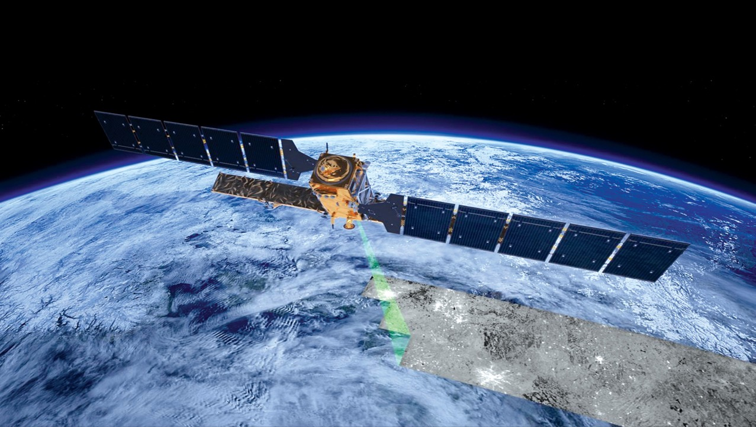
Earth observation data analysis in the age of big data
image: ESA

Slide 2
The age of big Earth observation data
Terra
Sentinel-1/1A
Sentinel-2/2A
Landsat-8
Sentinel-3
CBERS-4/4A

Slide 3



The new digital economy
images: shutterstock
Low access cost
big data
public APIs
massive use
Google, Weibo, Twitter/X, WeChat, Waze,…

Slide 4


How to share and process so much EO data?
Cloud services: move the user to the data!

Slide 5
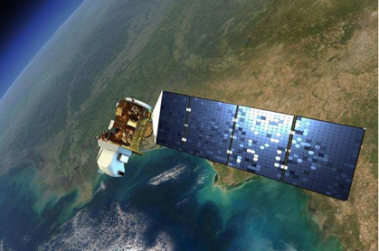
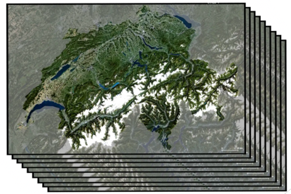
Big EO data for sustainable development
Big satellite data
(2PB per day)
Data in cloud services
Machine learning
(classification)
images: NASA, Swiss Data Cube, ECMWF

Slide 6


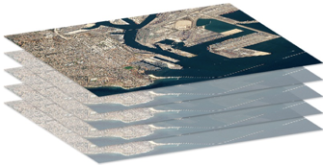
What the global EO community needs
images: shutterstock
Empowered institutions
Reusable, shared knowledge
Cloud
platforms

Slide 7
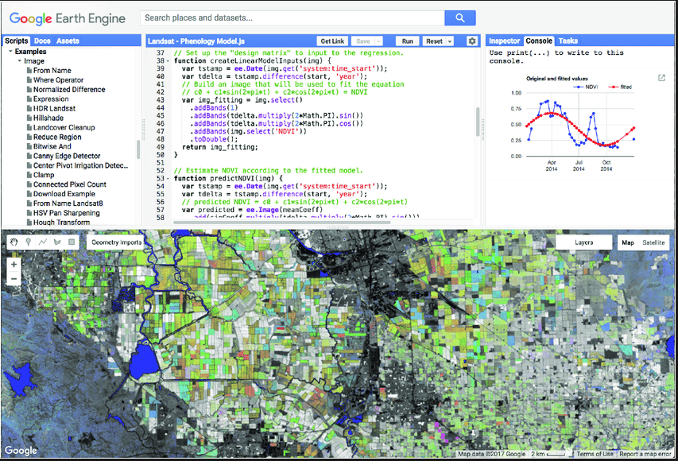
Google Earth Engine: Silicon Valley comes to Earth observations
Global enabler (2.000+ papers): low entry cost to big Earth observation data analysis

Slide 8
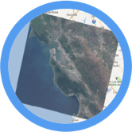

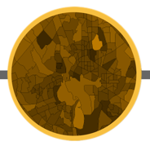
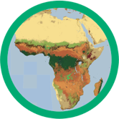

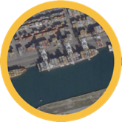
Earth Engine Data Catalog
Landsat & Sentinel 1, 2
10-30m, weekly
MODIS
250m daily
Vector Data
WDPA, Tiger
Terrain &
Land Cover
Weather & Climate
NOAA NCEP, OMI, ...
... and upload your own vectors and rasters
> 200 public datasets
> 4000 new images every day
> 5 million images
> 7 petabytes of data
source: Nick Clinton (Google)
Notes:
Landsat data. Whatever USGS has, Earth Engine has. Landsats 1-8. Raw, TOA reflectance, surface reflectance. Sentinels 1-2. TOA reflectance. SAR data from Sentinel-1 processed to backscattering coefficients. Most MODIS terrestrial composites. Global DEMS at a variety of resolutions. Multiple land cover datasets. Atmosphere and climate data. And growing daily. There is a one or two day latency between scene acquisition and when it is ingested to the catalog.

Slide 9
GEE: functional programming paradigm
// select an image collection
var col_l8 = ee.ImageCollection('LANDSAT/LC08/C01/T1_TOA’);
// get a data cube (called “Image” in GEE)
var landsat2016 = l8.filterDate('2016-01-01', '2016-12-31’);
// Compute the Normalized Difference Vegetation Index (NDVI). var nir = image.select('B5'); var red = image.select('B4'); var ndvi = nir.subtract(red).divide(nir.add(red)).rename('NDVI');

Slide 10
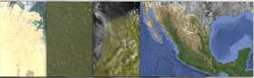

Requests
Results
Geospatial Datasets
add
mosaic
distance
filter
Algorithmic Primitives
join
focal_min
convolve
reduce
Storage and Compute
source: Nick Clinton (Google)
Notes:
"Cloud computing: it's as if you had access to a supercomputer designed for geospatial analysis." All the heavy lifting is done on Google servers. Getting the result is low bandwidth.
How does it work? The code you write in the Code Editor gets turned into an object representing the set of instructions which is then sent to Google for processing. The analysis you requested is then run in parallel on many computers. What you get back in your browser is only what you request, for example a statistic or chart printed to the console or small RGB tiles to display on the Map. This is low bandwidth, but it's as if you have access to a supercomputer for geospatial analysis.

Slide 11


Slide 12
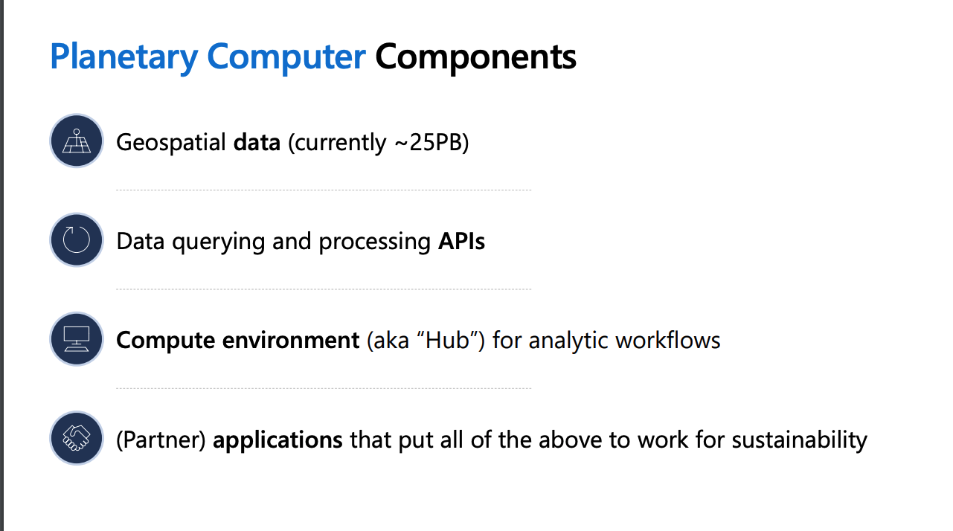

Slide 13
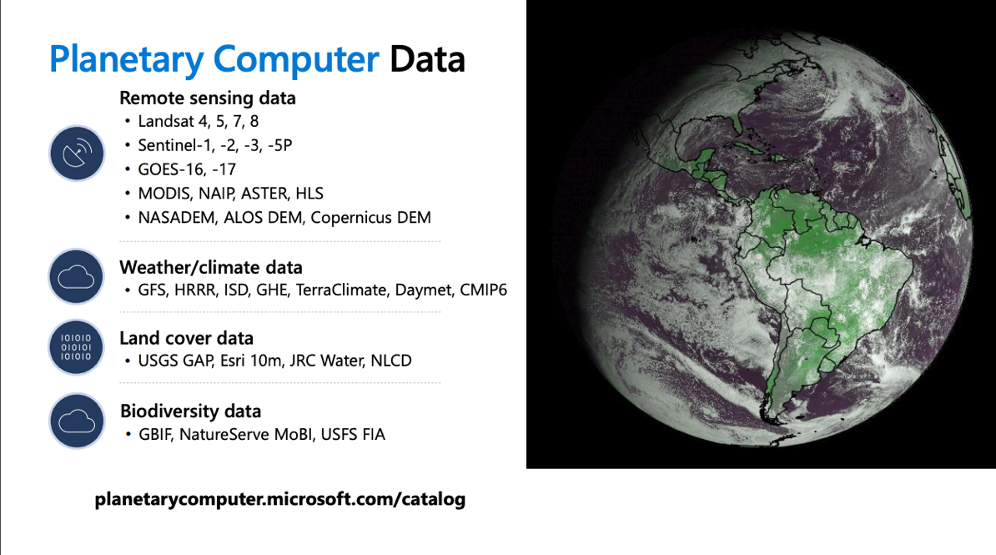

Slide 14
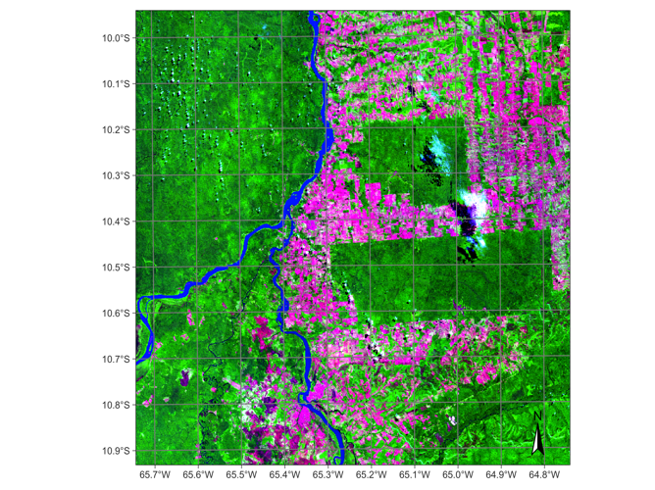
Processing data in MPC
# create a data cube covering an area in the Brazilian Amazon
s2_20LKP_cube_MPC <- sits_cube(
source = "MPC",
collection = "SENTINEL-2-L2A",
tiles = "20LKP",
bands = c("B02", "B8A", "B11", "CLOUD"),
start_date = "2019-07-01",
end_date = "2019-07-28"
)
# plot a color composite of one date of the cube
plot(s2_20LKP_cube_MPC, red = "B11", blue = "B02", green = "B8A", date = "2019-07-18")

Slide 15
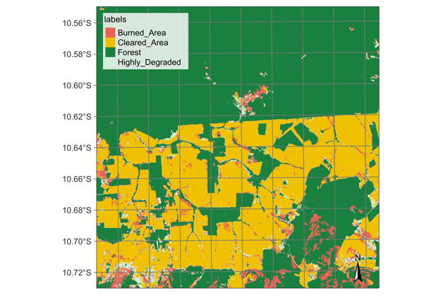
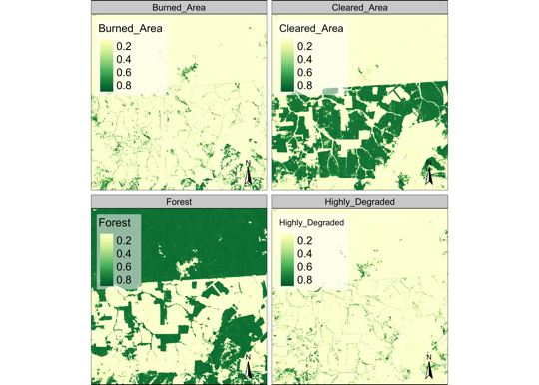
Processing data in MPC
# classify data cube
ro_cube_20LKP_probs <- sits_classify
(data = ro_cube_20LKP,
ml_model = ltae_model)
plot(ro_cube_20LKP_probs
# generate thematic map
defor_map <- sits_label_classification
(cube = ro_cube_20LKP_probs)
plot(defor_map)

Slide 16
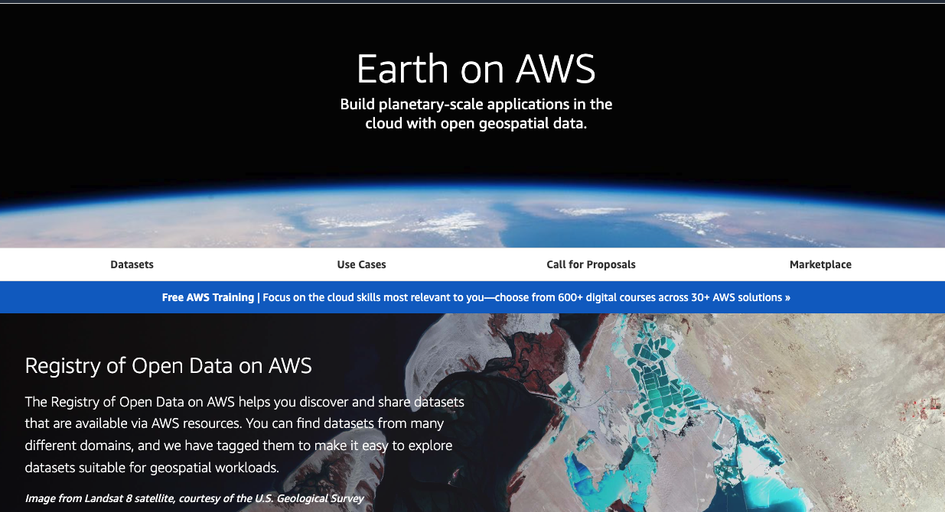

Slide 17
Open Data Cube
# Creating a collection
dc = datacube.Datacube(app='dc-visualize’)
# loading a data cube
ds = dc.load(
product='ls8_level1_usgs’,
measurements = ('red','green','blue’))
Define a collection
Load a data cube in memory

Slide 18
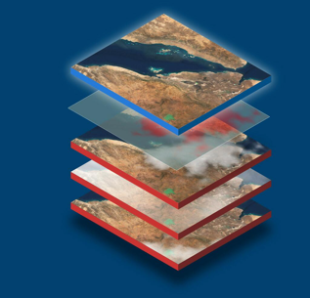
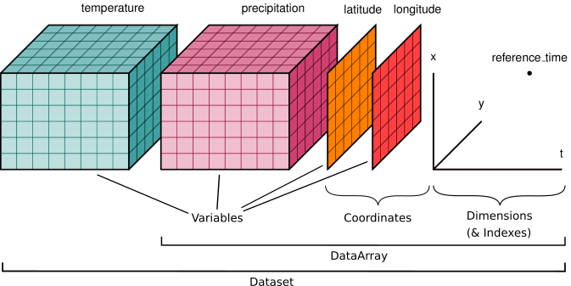

Data cubes in ODC
ARD Image files
Catalogue
Data cubes on-the-fly (Xarray)
No API beyond Xarray generation
(freedom or barrier?)
images: EOX, ODC, Xarray

Slide 19
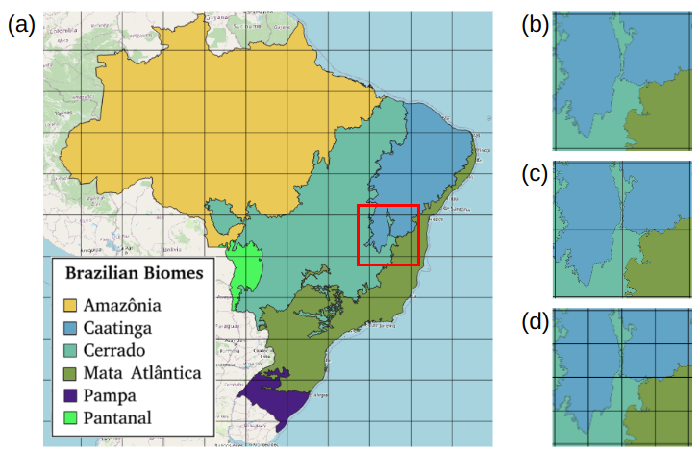


Slide 20

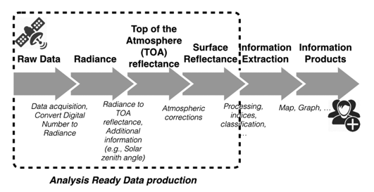

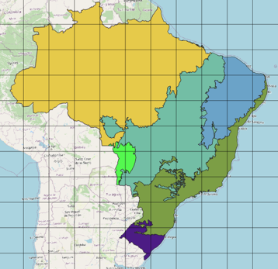
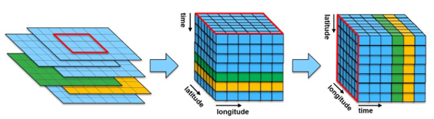
ARD and EO Data Cubes for Brazil
Sentinel-2
Landsat-8 / -9
CBERS-4 / 4A (MUX / WFI)
2 Petabytes (PB)
remote sensing images
CEOS Analysis Ready Data (ARD) for Land:
https://ceos.org/ard/index.html
Source: [Giuliani et al, 2017]
Collections of ARD satellite imagens
Multidimensional Data cubes
BDC Hierarchical Tiling System
Source: [Kopp et al, 2019]

Slide 21
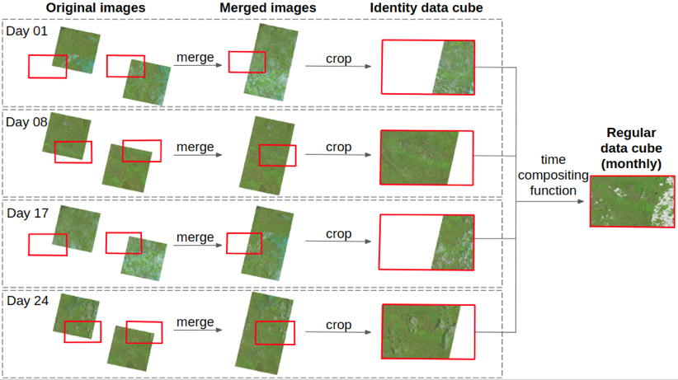
ARD and EO Data Cubes for Brazil
*bilinear resampling for better spatial resolution band
BDC Hierarchical Tiling System

Slide 22
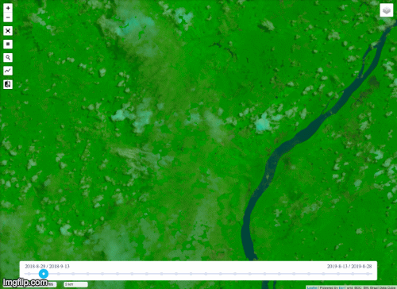
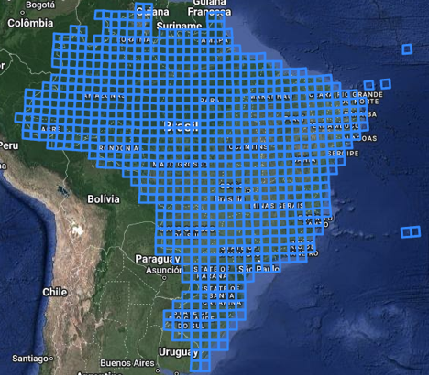
brazildatacube.dpi.inpe.br/portal/explore
For each tile and time step, there are a set of COG (Clould Optimized GeoTIFF) files:
(1) Spectral bands from original images; (2) Vegetation indices (EVI and NDVI); (3) Cloud mask; (4) number of valid observations (excluding cloud, cloud shadow..); (5) data provenace; ...
...
time
...
Day n
BDC – Small
Each tile: 105600m x 105600m
Sentinel-2/MSI – 10 meters
Each file (band/tile): 400 MB
Each tile: ~ 5.4 GB
...
Day 16
Day 0

Slide 23
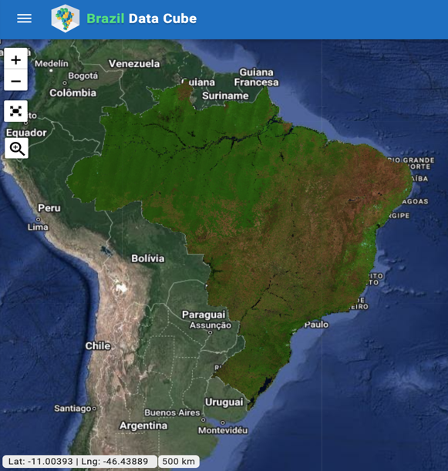
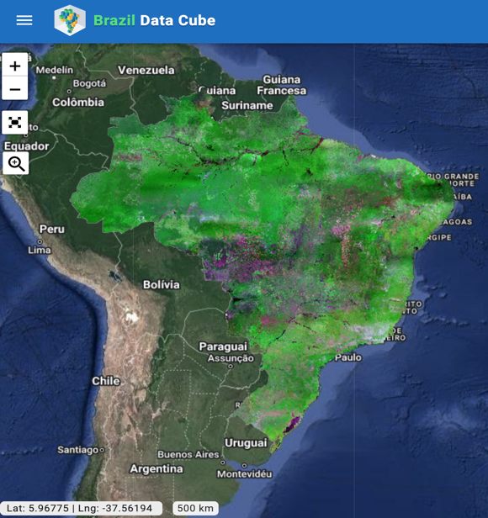
Landsat-8 - OLI - Brazil
CBERS-4 WFI - Brazil

Slide 24
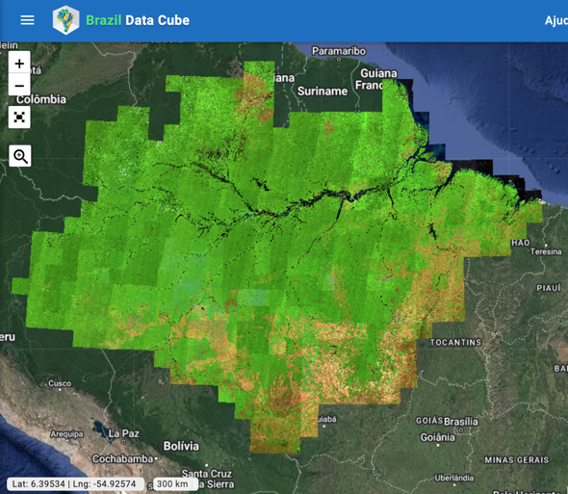
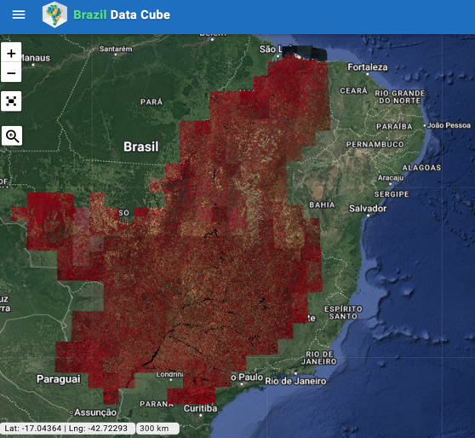
Sentinel-2 - MSI - Amazonia
Sentinel-2 - MSI - Cerrado

Slide 25

Copernicus Data Space Ecosystem

Slide 26





Building an open ecosystem
Initially configured open and free capacity
e.g. Configured Number of parallel downloads per user
Extended open & free capacity
Extended open and free capacity
e.g. increased data access capacity according to user scenario evolution
Open & free service with configured operational capacity
Seamless expansion for large-scale use under commercial models by 3rd party operators
API
Extended commercial 3rd party capacity
Extended capacity with commercial 3rd party services
(direct agreement between user and third party)
e.g. Dedicated user data access capacity
3rd party services
3rd party service
* 3rd Party services preserving identity and governance
3rd party service
3rd party service
3rd party service

Slide 27










Full flexibility for users access management
One single entry point configurable to support the needs of different user groups
Data access services capacity configured for different user groups
User group membership governance ESA & EC
Open & free service with configured operational capacity
General users
Standard quota
Copernicus Services
Priviledged service capacity
API
Collaborative National Entities
Priviledged service capacity
International Agreements
Ad-hoc service capacity

Slide 28
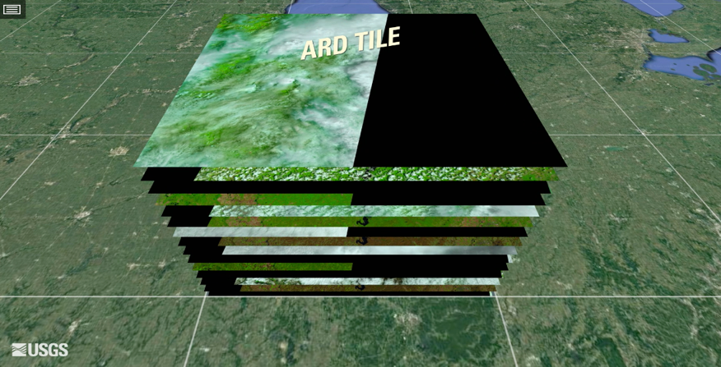
What is an ARD image collection?
Image collections are not regular in space and time.
Bands may have different resolutions.
Temporal intervals may be irregular.

Slide 29
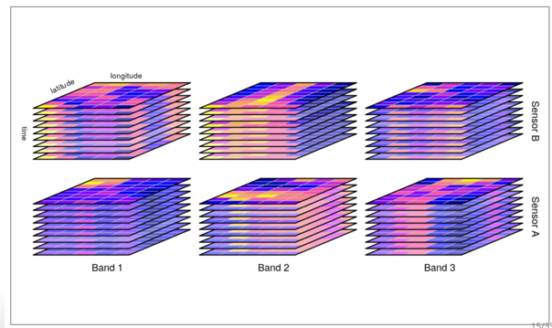
What is an ARD image collection?
An image collection is a set of 2D images, where each image contains spectral bands. All bands from one image share a common spatial footprint, acquisition date/time, and spatial reference system. Images in a collection may have different pixel sizes.
source: Appel and Pebesma (2018)

Slide 30

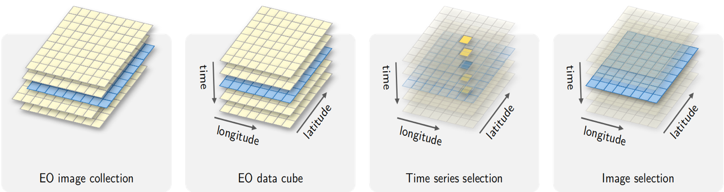
What is an EO data cube?
Data cube = regular partitions of space and time

Slide 31
What is a data cube?
A regular, dense raster data cube is a four-dimensional array with dimensions x (longitude or easting), y (latitude or northing), time, and bands with the following properties:
Spatial dimensions refer to a spatial reference system (SRS);
Cells of a data cube have a constant spatial size;
The cube axes are aligned with the SRS axes;
The temporal reference is a known set of temporal intervals;
For every combination of dimensions, a cell has a single (real) attribute value.
adapted from Appel and Pebesma (2018)

Slide 32
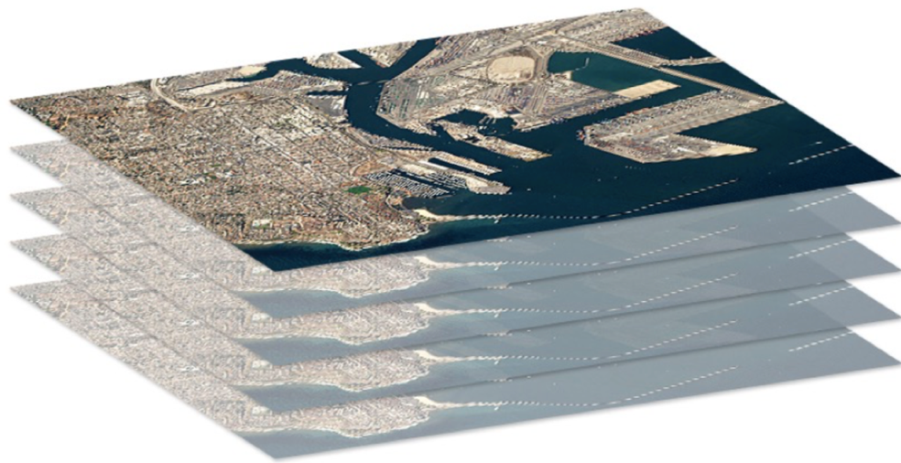
Data Cube
image: Swiss Data Cube
positions: 2D values: time series
An Australian Geoscience Data Cube

Slide 33







Accessing image collections with STAC
Digital Earth Africa
Brazil Data Cube
Earth on AWS
SEPAL
Planetary Computer
Notes:
O sits é baseado em tecnologias Web para ter acesso às coleções de imagens. O uso do protocolo STAC, do qual falaremos um pouco mais no último capítulo, facilita a interoperabilidade entre diferentes repositórios de dados e plataformas de computação em nuvem.
Atualmente o sits fornece suporte aos dados do Sentinel, Landsat, CBERS e MODIS no projeto BDC, Sentinel-2 e Lansat do repositório Digital Earth Africa na AWS e do Sentinel-2 da AWS.
Estamos desenvolvendo o suporte para os repositórios da AI for Earth da Microsoft e o ambiente de cloud da SEPAL.

Slide 34



Accessing image collections with STAC
Digital Earth Africa
Brazil Data Cube
Earth on AWS
SEPAL
AI for Earth
Notes:
O sits é baseado em tecnologias Web para ter acesso às coleções de imagens. O uso do protocolo STAC, do qual falaremos um pouco mais no último capítulo, facilita a interoperabilidade entre diferentes repositórios de dados e plataformas de computação em nuvem.
Atualmente o sits fornece suporte aos dados do Sentinel, Landsat, CBERS e MODIS no projeto BDC, Sentinel-2 e Lansat do repositório Digital Earth Africa na AWS e do Sentinel-2 da AWS.
Estamos desenvolvendo o suporte para os repositórios da AI for Earth da Microsoft e o ambiente de cloud da SEPAL.

Slide 35
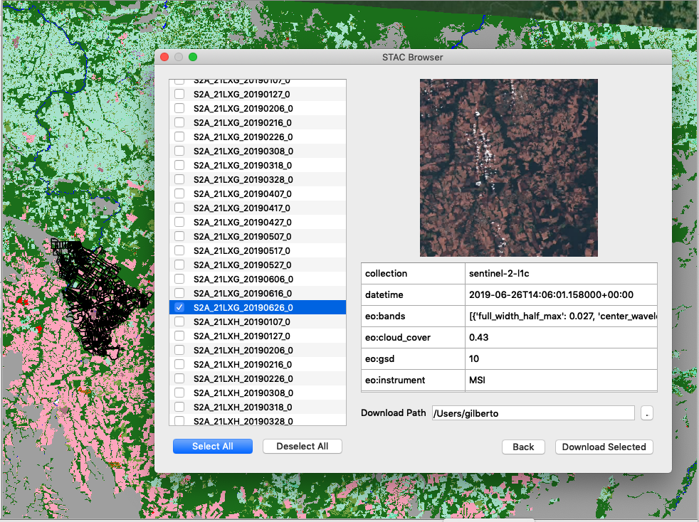
STAC browser in QGIS
STAC provides API to access image collections

Slide 36
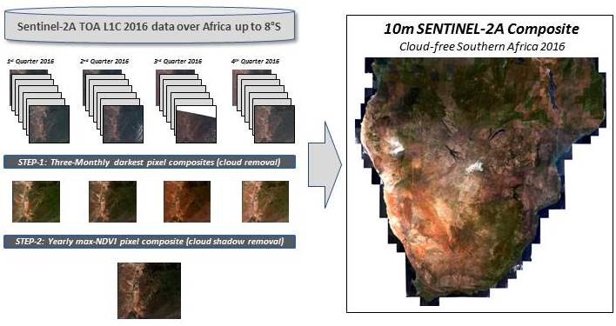
Multitemporal composite

Slide 37
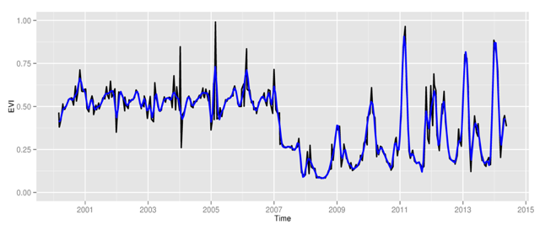
Space first, time later or time first, space later?
Space first: classify images;
compare results in time
Time first: classify time series;
join results to get maps
graphics: V Maus, author

Slide 38
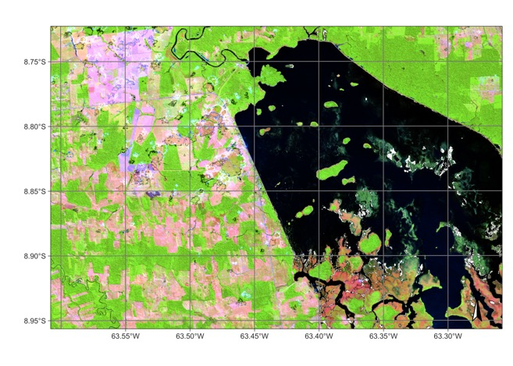
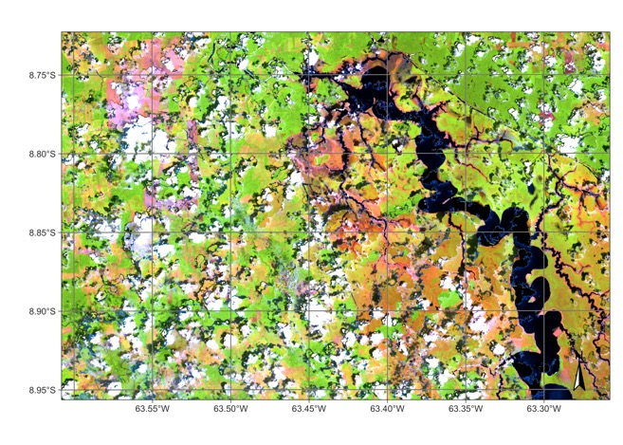
What’s in an image time series?
Searching for changes instead of searching for content. (Camara et al., “What’s in an image?”, COSIT 2001)

Slide 39


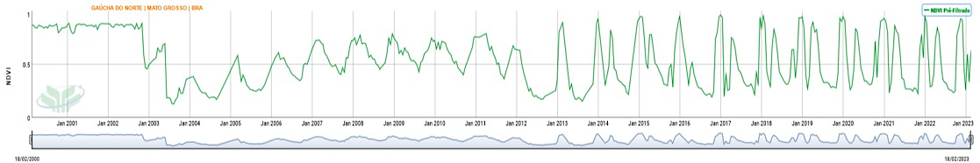
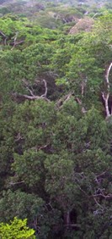

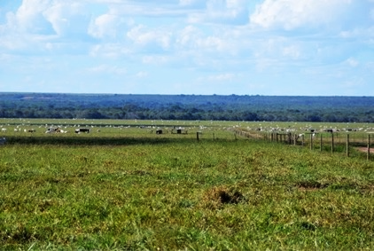
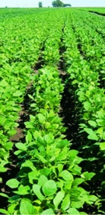
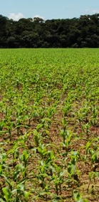
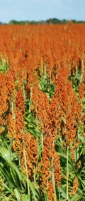
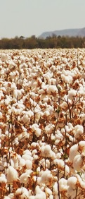
Time Series showing changes
Desmatamento
Floresta
Pastagem
Culturas Agrícolas Temporárias
Embrapa Agricultura Digital
39

Slide 40


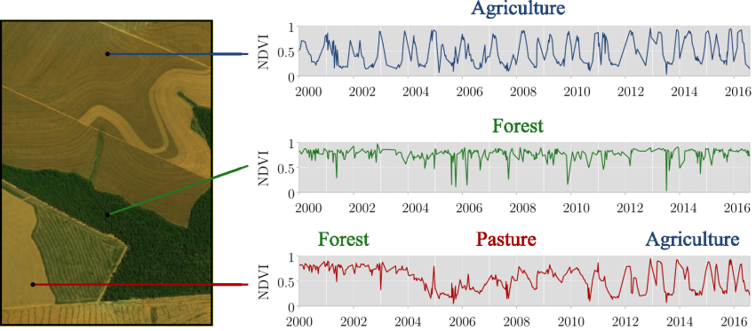
Give users all the data!
Using time series – significant increase in LUCC accuracy
graphics: Maus, Victor
Notes:
Uma questão que emerge imediatamente como consequência dessa escolha é:
“Como classificar cobertura e uso da Terra usando séries temporais?”
Aqui nessa imagem, nós podemos ver séries temporais de NDVI do sensor MODIS de diferentes localizações entre os anos 2000 e 2016.
Na primeira, constatamos uma série típica de agricultura. Na segunda, uma série típica de cobertura florestal. Na terceira, observamos uma trajetória de mudanças, começando com floresta, depois pastagem e, na sequência, agricultura.

Slide 41


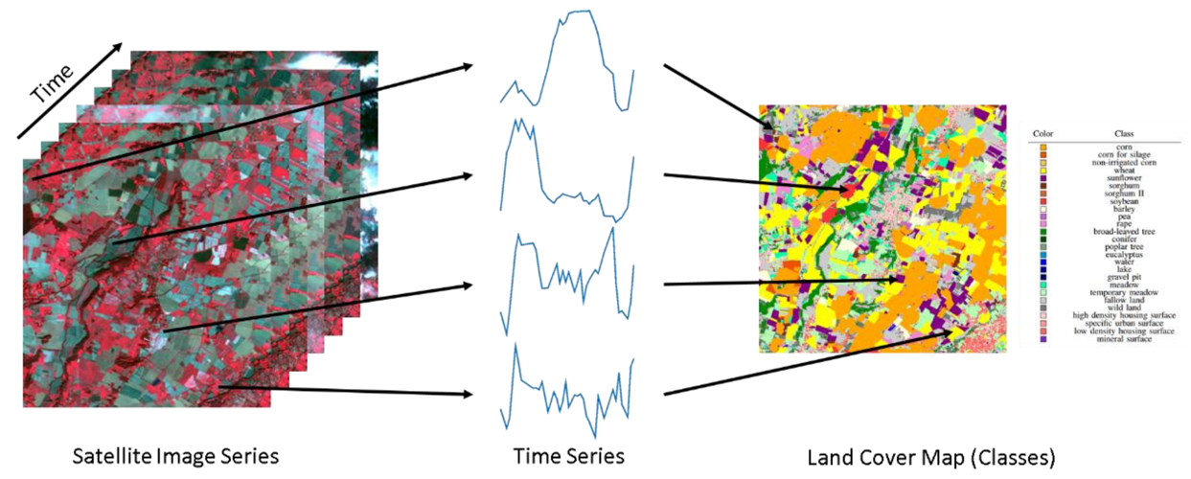
Land classification with image time series
image: F Petitjean, Monash Univ
Notes:
Sits is an R package for Satellite Image Time Series Analysis for Earth Observation Data Cubes.
This package provides a simples API for a complete and complex workflow for land classification from big EO data sets.
It provides funcionalities to:
Create and define earth observation data cubes
Assess and improve land use and cover samples using neural network and Self-Organizing maps (SOM)
Train different kinds of machine learning methods using land use and cover samples
Classify the data cube using the trained model.
Perform some kind of post-processing (such as smoothing) to generate the final map.
Spatial smoothing methods remove outliers from the classification.

Slide 42
Big EO data analysis in practice
Obtain and harmonise ARD
Collect training data (in-situ)
Put ARD in a cloud collection
Quality control on training data
Build a data cube
Select ML method
Train data set
Classify data
Smoothen data
Post-processing

Slide 43
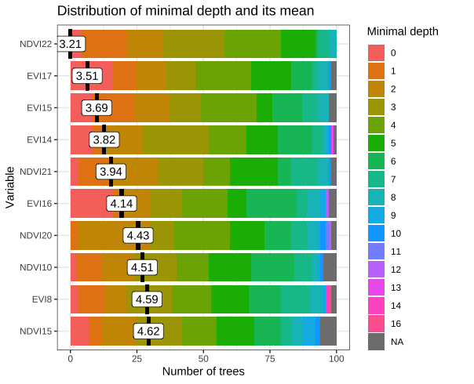

Random forest method for time series analysis

Slide 44
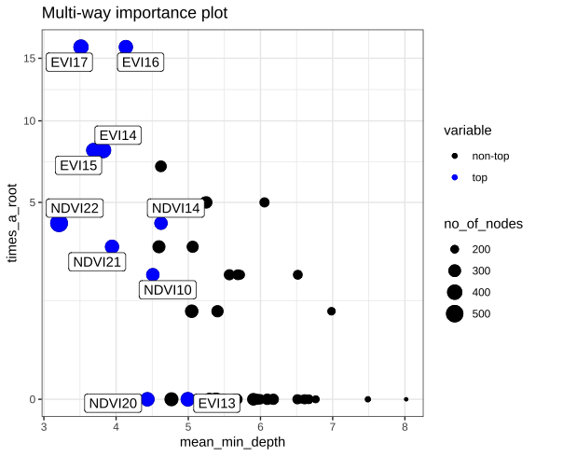
Random forest method for time series analysis

Slide 45
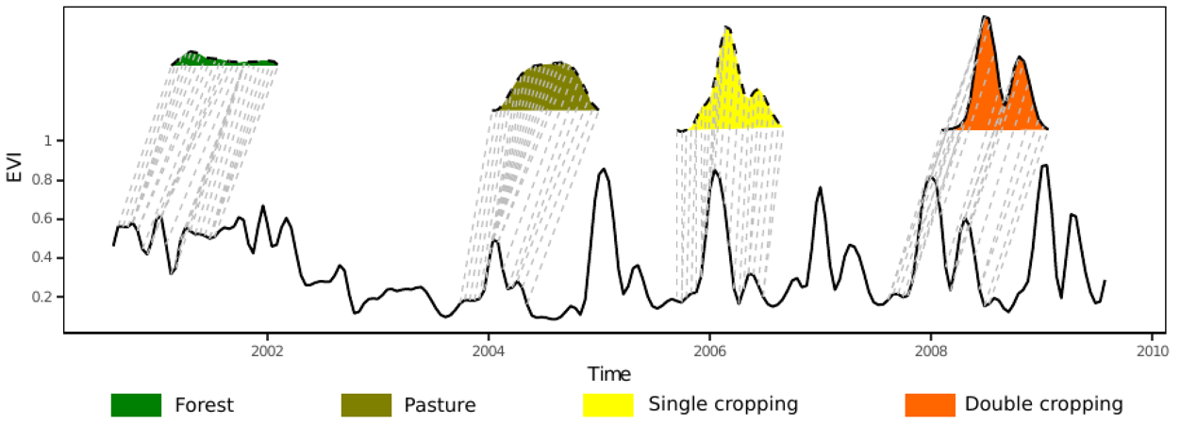
TWTDW method for time series analysis
“A Time-Weighted Dynamic Time Warping Method for Land-Use and Land-Cover Mapping” (Maus, Câmara et al, 2016)
“dtwSat R Package” (Maus et al., 2019)
graphics: V Maus (Univ of Vienna)

Slide 46

TWDTW does pattern matching
Finding subsequences in a time series by pattern matching
Patterns are idealized, data is noisy
Esling & Agon (2012)

Slide 47


Dynamic Time Warping: pattern matching
DTW “warps” the time axis: nonlinear matching

Slide 48

Temporal patterns of different classes used by TWTDW
graphics: author

Slide 49
TWDTW for remote sensing time series
TWDTW finds alignments of short templates in a long time series
considering the agricultural calendar

Slide 50

TWDTW classification

Slide 51

TWDTW classification

Slide 52

TWDTW classification
Victor Maus

Slide 53

Temporal Convolutional Neural Network for remote sensing time series classification
TempCNN measures short-term and long-term relations in time series

Slide 54

TempCNN for remote sensing time series classification
Each hidden layer captures different relations between elements of the time series

Slide 55


LULC classification using TempCNN
Cerrado biome (200 million ha)
LULC map for year 2018
48,850 samples (TempCNN model)
Landsat-8 16-day time series
8 TB processed in 24 hours
10 LULC classes (86% accuracy)

Slide 56

Easy-to-learn API
Target user community: Earth science experts

Slide 57





SITS – image time series analysis in R
section title / slide title
https://github.com/e-sensing/sits

Slide 58

SITS workflow
Notes:
Uma das formas de classificar uma série temporal é passando os dados da série temporal diretamente para algoritmos de aprendizado de máquina.
Primeiramente, as séries temporais devem vir de algum lugar. Conceptualmente, as séries temporais vem de cubos de dados de observação da Terra, que são imagens organizadas que representam as dimensões espaciais (x e y) e a temporal.
Usando amostras que indicam um intervalo de datas e uma localização espacial associados a uma classe de uso e cobertura da Terra, podemos treinar modelos de aprendizado de máquina para gerar mapas de uso e cobertura.

Slide 59
Easy-to-learn API
Target user community: Earth science experts

Slide 60
SITS equivalent to Google Earth Engine
// select an image collection
l8_cube = sits_cube(source = 'MSPC',
collection = 'LANDSAT-8-C2-L2',
tiles = '232067',
start_date = '2016-01-01’,
end_date = '2016-12-31’)
// get a regularized data cube
l8_cube_reg = sits_regularize(l8_cube, period = “P16D”, res = 30)
// Compute the Normalized Difference Vegetation Index (NDVI). l8_cube_reg = sits_apply(l8_cube_reg, NDVI = (B05 – B04)/(B05 + B04))

Slide 61




Cerrado: Brazilian savanna
Cerradão (woodland)
Cerrado strictu sensu
Open cerrado
images: Del-Claro and Silingardi (Annals Brazilian Academy Sci, 2019 )

Slide 62

Locally relevant?

Slide 63


Natural or man-made landscapes?
Natural savanna (Brazilian Cerrado)
Cattle in pasture (in the Cerrado)
images: Nature Conserv, Alamy

Slide 64
LULC classification
Cerrado biome (200 million ha)
LULC map for year 2018
48,850 samples (TempCNN model)
Landsat-8 16-day time series
8 TB processed in 24 hours
10 LULC classes (86% accuracy)

Slide 65

Simple and stable API
200 million ha
classified using
six commands

Slide 66




ESA World Cover 2020
BDC Cerrado

Slide 67


TerraClass Cerrado 2022
Sentinel-2, 10bands, 10 meter, 16 days, TempCNN method with 87.500 samples, Accuracy: more than 91% UA and PA for core classes.
67
Bertolo (2023)

Slide 68


Deforestation in Amazonia: PRODES
Transparent and authoritative data: REDD+ funds (US$ 1,3 billion), decision-makers (Brazil’s NDC), researchers (1,000+ papers)

Slide 69




Deforestation in Rondônia
~238.000 km²
Sentinel 2A composição R11G8B2

Slide 70

Visual interpretation is hard for ML to beat…

Slide 71

Event-based samples (model estimates)
Burned area
Cleared area
Forest
Forest cut with regeneration

Slide 72



Clear Cut Bare Soil
Clear Cut w/ vegetation
Clear Cut w/ fire
How to measure these events?

Slide 73




Seasonally-flooded areas
Riparian forests

Slide 74

Time series patterns
Clear Cut Bare Soil
Clear Cut Fire
Mountain Side Forest
Forest
Riparian Forest
Clear Cut Vegetation
Water
Seasonally flooded
Wetlands

Slide 75


Sentinel-2 (10/2022)
SITS map (2022)

Slide 76



Comparison SITS and visual interpretation
August/2022
95% agreement

Slide 77

Object-based image time series analysis

Slide 78


Slide 79


Slide 80





















Karine
Lúbia
Lorena
Michelle
Isabel
Charlotte
Ana Paula
Ana Rorato
Anielli
Lidia
Gleyce
Luciana
Gilberto
Felipe
Rolf
Pedro
Alber
João
Alex
Julio
Sadeck
Claudio
Mateus
Breno
Julio

